Slide 1
Unit 6 Exponents

Slide 2
Group Work Questions
#1
#2
#3
#4
#5
1,
2,
#6
#7
#8
#9
#10
2,
3,
1,
2,
2,
1,
3,
1,

Slide 3
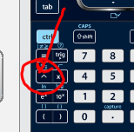
Tuesday Feb 18, 2020 Activator
Evaluate the following for y.
$${y=5}^{2}(5^{3})$$
Where is the exponent button?
y = 3125
y = (5)(5)(5)(5)(5)
y = 3125
Page #3
Lesson 6.1

Slide 4
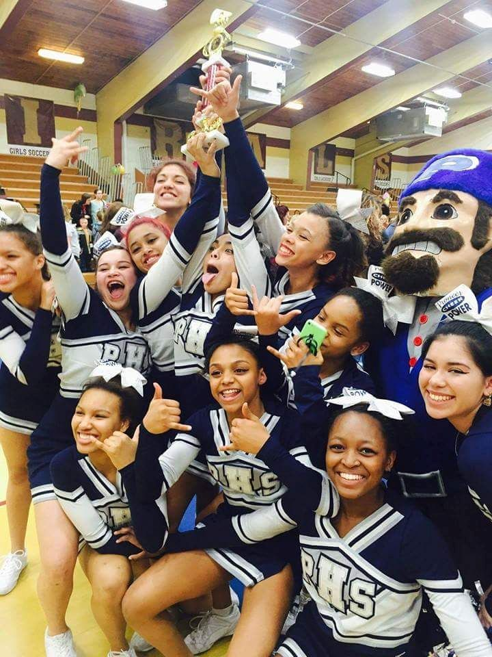
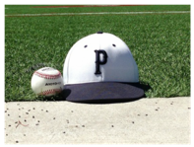
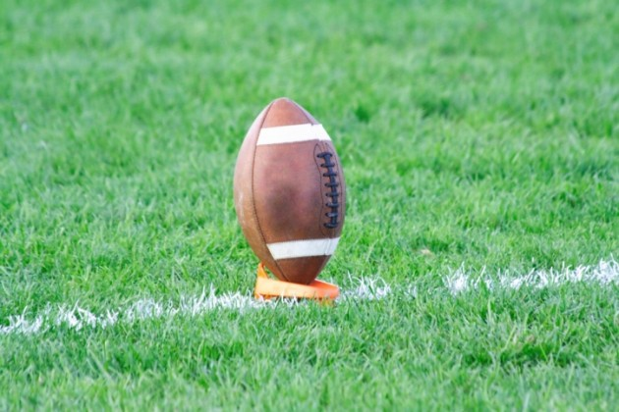
Today’s Objective
Unit 6
Lesson 1
Students will be able to multiply, divide, and expand with exponents.

Slide 5
Mon(x) | Tue(B) | Wed(C) | Thur(D) | Fri(A)
President’s Day | Lesson 6.1 | x | Lesson 6.2 | x
Mon(B) | Tue(C) | Wed(D) | Thur(A) | Fri(B)
Lesson 6.3 | x | Lesson 6.4 | x | Lesson 6.5

Slide 6
Announcements
Tutoring: Friday 7:45-8:30,
Test #5 during the last 30 minutes today.
Test #5 10% Questions are #1,#2,#11,#13
Max of 20 chips can be added for +5%.
You must receive at least a 65%, or you
must stay after school to complete it.

Slide 7
Today’s New Vocab (1 of 4)
Write in expanded notation and simplify.
Where is the exponent button?
$$4^{3}(4^{2})$$
$$x^{3}(x^{2})$$
(4)(4)(4)$(4)(4)$
(x)(x)(x)$(x)(x)$
$$4^{5} or 1,024$$
$$x^{5}$$
Page #3
Lesson 6.1

Slide 8
Today’s New Vocab (2 of 4)
Write in Expanded notation. Then, simplify.
$${(3^{2})}^{4}$$
Page #3
Lesson 6.1
$${(y^{2})}^{4}$$
.
($3^{2}$)($3^{2}$)($3^{2}$)($3^{2}$)
($y^{2}$)($y^{2}$)($y^{2}$)($y^{2}$)
(3$∙3$)($\text{3}∙3$)($\text{3}∙3$)($\text{3}∙3$)
(y$∙$y)($\text{y}∙$y)($\text{y}∙y$)($\text{y}∙y$)
3$∙3∙\text{3}∙3∙\text{3}∙3∙\text{3}∙3$
$$y∙y∙\text{y}∙y∙\text{y}∙y∙\text{y}∙y$$
$3^{8}$ or 6,561
$$y^{8}$$

Slide 9
Today’s New Vocab (3 of 4)
Write in Expanded notation. Then, simplify.
$$\frac{2^{7}x^{4}}{2^{3}x}$$
$$\frac{\left(2\right)\left(2\right)\left(2\right)\left(2\right)\left(2\right)\left(2\right)\left(2\right)xxxx}{\left(2\right)\left(2\right)\left(2\right)x}$$
$$\left(2\right)\left(2\right)\left(2\right)\left(2\right)xxx$$
$$2^{4}x^{3}$$
Page #3
Lesson 6.1

Slide 10
Today’s New Vocab (4 of 4)
Are the two problems equivalent (equal)?
Yes
$${(2x^{3})}^{2} and {4x}^{6}$$
(2$x^{3}$)(2$x^{3}$) 4xxxxxx
(2)(x)(x)(x)(2)(x)(x)(x)
$$2^{2}x^{6}$$
Page #4
Lesson 6.1
$${4x}^{6}$$

Slide 11
GWQ’s
Page #1-2
Lesson 6.1
#15 is a fraction answer.
#1
#2
#3
#4
#5
#6
#7
#8
#9
#10
24,21,12,7,36
24,21,12,7,36
26,22,13,1,45
26,22,13,1,45
28,19,16,4,44
28,19,16,4,44
30,18,16,9,43
30,18,16,9,43
25,17,14,5,39
25,17,14,5,39

Slide 12
Tuesday Feb 18, 2020 Work Period
What is the product of 8.05 $∙$ ${10}^{6}$ and 3.5 $∙$ ${10}^{2}$ ?
(8.05)(10)(10)(10)(10)(10)(10) $∙$ (3.5)(10)(10)
(8.05)(3.5)(10)(10)(10)(10)(10)(10)(10)(10)
(8.05)(3.5)(${10}^{8})$
(28.175)(${10}^{8})$
Page #4
Lesson 6.1
(2.8175)(${10}^{8+1})$
(2.8175)(${10}^{9})$

Slide 13
Tuesday Feb 18, 2020 Exit Ticket
The product (multiplication) of $(3{x)}^{2}$ and 6$x^{3 }$
Write in expanded notation.
.
(3x)(3x) $∙$ (6)(x)(x)(x)
What property?
(3)(3)(6)(x)(x)(x)(x)(x) commutative
54$x^{5}$
Page #4
Lesson 6.1

Slide 15
Thursday Feb 20, 2020 Activator
What are the next three in the sequence?
800, 400, 200, ____, ____, ____
-6, 18, -54, ____, ____, ____
100
50
25
Pattern?
$$Divide by 2$$
Multiply$by \frac{1}{2}$
162
-486
1458
Page #7
Lesson 6.2
Pattern?
Multiply$by$
(-3)
Today, we are doing horizontal tables.

Slide 16
Today’s Objective
Unit 6
Lesson 2
Students will be able write Geometric sequences.

Slide 17
Mon(x) | Tue(B) | Wed(C) | Thur(D) | Fri(A)
President’s Day | Lesson 6.1 | x | Lesson 6.2 | x
Mon(B) | Tue(C) | Wed(D) | Thur(A) | Fri(B)
Lesson 6.3 | x | Lesson 6.4 | x | Lesson 6.5

Slide 18
Announcements
Best in Class
Tutoring: Fri 7:45-8:30 Mon 2:45-3:45
Test 5 is in Yellow, Q3 Progress Pink
Q3 Progress Grades go home on March 6th
Make sure you picked up HW 6 due on Mar 13th

Slide 19
Today’s New Vocab (1 of 4)
How do you determine the pattern?
$$\frac{a_{2}}{a_{1}}$$
3, 6, 12, 24
900,300,100,33.3
$\frac{a_{2}}{a_{1}}$ = $\frac{6}{3}=2$
$a_{1}$,${ a}_{2}$, $a_{3}$, $a_{4}$
Multiply by 2
$\frac{a_{2}}{a_{1}}$ = $\frac{300}{900}=\frac{1}{3}$
$a_{1}$,${ a}_{2}$, ${ a}_{3}$, $a_{4}$
Divide by 3
Page #7 Lesson 6.2

Slide 20
Today’s New Vocab (2 of 4)
Make a table for this pattern.
$$a_{x}=3 {(2)}^{x−1}$$
$$a_{n}=3 {(2)}^{n−1}$$
n | a(n)
0 | 1.5
1 | 3
2 | 6
8 | 384
Do you enter the “n” into the calculator? No, the calculator can only read x as the unknown number.
Page #7
Lesson 6.2

Slide 21
Today’s New Vocab (3 of 4)
Use Algebra to determine the 8th number.
Page #8
Lesson 6.2
3, 6, 12, …
X used to make a table and graph.
$$a_{x}=3 {(2)}^{x−1}$$
$a_{n}=is the$ answer
$a_{1}$= the first blank
r = the change (or ratio)
n = number we are finding
$$a_{8}=3 {(2)}^{8−1}$$
$$a_{8}=384$$

Slide 22
Today’s New Vocab (4 of 4)
Geometric Sequence (Division)
What is the pattern (r) and what is $A_{7}?6$
($\frac{1}{2}$)
384, 192 ,__ , ___, ___, ___, ___
$$a_{1}$$
$a_{2}$
$$a_{3}$$
$$a_{5}$$
$$a_{6}$$
$$a_{4}$$
$$a_{7}$$
$r=\frac{a_{2}}{a1}=\frac{192}{384}$ = $\frac{1}{2}$
Page #8
Lesson 6.2

Slide 23
Group Work Questions
Page #5-6
Lesson 6.2
#1
#2
#3
#4
#5
2,5,9,11,13,15
#6
#7
#8
#9
#10
3,6,10,12,14,16
3,6,10,12,14,16
2,5,9,11,13,15
2,5,9,11,13,15
3,6,10,12,14,16
3,6,10,12,14,16
2,5,9,11,13,15
2,5,9,11,13,15
3,6,10,12,14,16

Slide 24
Thursday Feb 20, 2020 Work Period
In a Geometric sequence, the 1st term is 6 and
the common ratio is 3. What is the 7th term ?
n | a(n)
0 | 2
1 | 6
2 | 18
7 | 4374
.
The
function
$$a_{x}=6 {(3)}^{x−1}$$
(3)
$$a_{7}=6 {(3)}^{7−1}$$
Page #8
Lesson 6.2
$a_{7}=$ 4374

Slide 25
Thursday Feb 20, 2020 Work Period
In a Geometric sequence, the 1st term is 6 and
the common ratio is 3. What is the 7th term ?
Write the pattern from $A_{1}to A_{7}$.
Page #8
Lesson 6.2
(3)
6, __, __, ___, ___, ___, ___
$$a_{1}$$
$$a_{2}$$
$${ a}_{3}$$
$${ a}_{4}$$
$${ a}_{5}$$
$${ a}_{6}$$
$${ a}_{7}$$

Slide 27
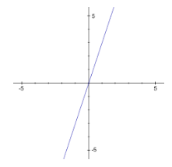
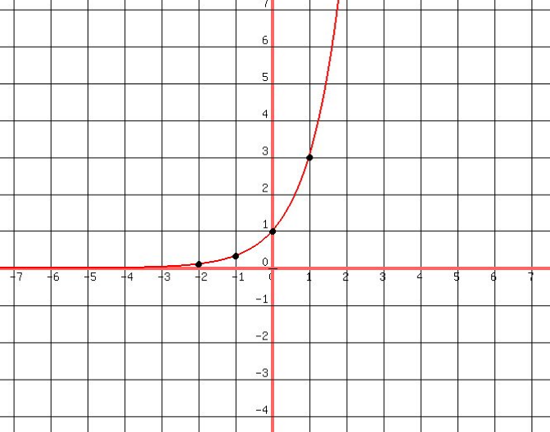
Monday Feb 24, 2020 Activator
Why/how is the right line curved?
There is an exponent in the function/equation.
Linear
(Straight)
Not Linear
(Not Straight)
Page #11
Lesson 6.3
f(x)= 3x
f(x) = $3^{x}$

Slide 28
Today’s Objective
Unit 6
Lesson 3
Students will be able to graph exponential functions.

Slide 29
Mon(x) | Tue(B) | Wed(C) | Thur(D) | Fri(A)
President’s Day | Lesson 6.1 | x | Lesson 6.2 | x
Mon(B) | Tue(C) | Wed(D) | Thur(A) | Fri(B)
Lesson 6.3 | x | Lesson 6.4 | x | 2B: L6.5 3B: Assembly and L6.5 5B: L6.5

Slide 30
Announcements
Best in Class
Friday Assembly: 3rd Period during ½ class
Tutoring: Mon 2:45-3:45, Fri 7:45-8:30
Test 5 is in Yellow, Q3 Progress Pink
Q3 Progress Grades go home on March 6th

Slide 31
Today’s New Vocab (1 of 4)
y = B ${(C)}^{x}$
What are exponential equations?
Curved lines with an exponent.
Example y = $2^{x}$ or f(x)= $2^{x}$
Page #11
Lesson 6.3
B = is the beginning and initial value (0,B) and
where the graph crosses the y axis.
(0, 1)
What is initial value
when f(x)= $2^{x}$ ? B = 1
x | f(x)
0 | 1
B

Slide 32
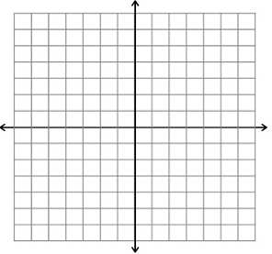
Today’s New Vocab (2 of 4)
Create a graph for y = $2^{x}$
over the interval
0 ≤ x ≤ 3.
x | f(x)
0 | 1
1 | 2
2 | 4
3 | 8
.
B
Page #11
Lesson 6.3
(2)
C = 2
Common (multiplier).
(2)

Slide 33
Today’s New Vocab (3 of 4)
Does the function model growth or decay?
f(x) = ${(2)}^{x}$
Growth. Why? C > 1
The graph goes up.
Page #11
Lesson 6.3
Decay. Why? C < 1
The graph goes down.
f(x) = ${(\frac{1}{2})}^{x}$
A multiplier of (1) keeps any number the same.

Slide 34
Today’s New Vocab (4 of 4)
If f(x) = ${(2)}^{x}$
y = B ${(C)}^{x}$
What is f(3)?
f(3) = 8
f(x) = ${(2)}^{x}$
Page #12
Lesson 6.3
f(3) = ${(2)}^{3}$
What is the common
multiplier? C = 2
f(3) =(2)(2)(2)
f(3) = 8

Slide 35
Group Work Questions
Page #9-10
Lesson 6.3
#1
#2
#3
#4
#5
2,4,3,10,14
#6
#7
#8
#9
#10
7,4,9,13,16
6,4,8,12,15
2,4,3,10,14
7,4,9,13,16
6,4,8,12,15
2,4,3,10,14
7,4,9,13,16
6,4,8,12,15
2,4,3,10,14

Slide 36
Page #12
Lesson 6.3
Monday Feb 24, 2020 WPeriod
Linear means “Straight line” no exponent
Not Linear mean “Not Straight Line or Curved line”
Create a table for f(x)=${ 4(\frac{1}{2})}^{x}$
over the interval −1 ≤ x ≤ 2.
x | f(x)
-1 | 8
0 | 4
1 | 2
2 | 1
.
Is this a linear table/graph?
No, Why? The line curves.

Slide 37
Monday Feb 24, 2020 Exit Ticket
What is f(4) for function?
Page #12 Lesson 6.3
Quadratic:
Number Exponent
Exponential:
Variable Exponent
f(x) = $x^{3}$f(x) = $3^{x}$
f(4) = ${(4)}^{3}$
f(4) = $3^{(4)}$
f(4) = (3)(3)(3)(3)
f(4) = (4)(4)(4)
f(4) = 64
f(4) = 81

Slide 39
Wednesday Feb 26, 2020 Activator
How are the two functions different?
What is k(4) and j(4)?
j(x) = 2x
k(x) = $2^{x}$
Not
Linear
Linear
j(4) = 2(4)
k(4) = $2^{(4)}$
j(4) = 8
k(4) = (2)(2)(2)(2)
x | j(x)
4 | 8
x | k(x)
4 | 16
Page #15
Lesson 6.4

Slide 40
Today’s Objective
Unit 6
Lesson 4
Students will be able to evaluate and graph exponential functions.

Slide 41
Mon(x) | Tue(B) | Wed(C) | Thur(D) | Fri(A)
President’s Day | Lesson 6.1 | x | Lesson 6.2 | x
Mon(B) | Tue(C) | Wed(D) | Thur(A) | Fri(B)
Lesson 6.3 | x | Lesson 6.4 | x | 2B: L6.5 3B: Assembly and L6.5 5B: L6.5

Slide 42
Announcements
Best in Class
Friday Assembly: 3rd Period during ½ class
Tutoring: Wed 2:45-3:15, Fri 7:45-8:30
Test 5 is in Yellow, Q3 Progress Pink
Q3 Progress Grades go home on March 6th

Slide 43
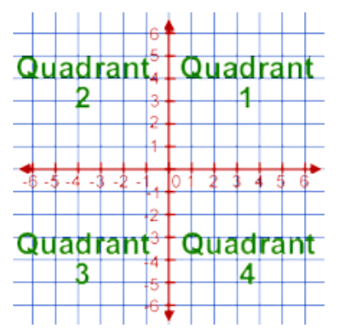
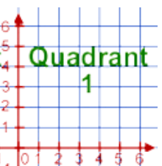
Picture of the day
Origin (0,0) in the center
Origin (0,0) in the corner
Zoom out
Zoom in

Slide 44
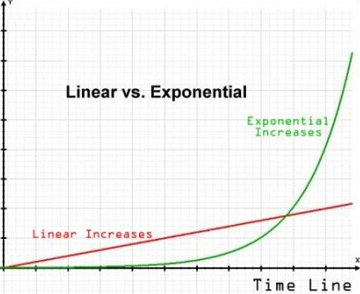
Today’s New (1 of 4)
The red line is linear and has NO exponent. The green line is exponential graph. It has an exponent.
Zoom in
Graph
Page #15
Lesson 6.4
Y = $\frac{x}{5}$
Y = $2^{x−8}$

Slide 45
Today’s New Vocab (2 of 4)
When x = 3, what is j(3) ?
x | j(x)
0 | 16
1 | 64
2 | 256
3 | 1024
Evaluate j(x) = ${16∙4}^{x}$
j(3) = ${16∙4}^{(3)}$
j(3) = 16 $∙$4(4)(4)
j(3) = 16$∙$64
j(3) = 1024
Is the point (3,1024) on the line j(x) = ${16∙4}^{x}$? Yes
Page #15
Lesson 6.4

Slide 46
Today’s New Vocab (3 of 4)
Evaluate k(x) = ${16∙\frac{1}{4}}^{x}$
When x = 2,
what is k(2) ?
k(2) = ${16∙\frac{1}{4}}^{(2)}$
x | k(x)
0 | 16
1 | 4
2 | 1
k(2) = 16 $∙$ $\frac{1}{4}$ $∙$ $\frac{1}{4}$
Page #15
Lesson 6.4
k(2) = 1

Slide 47
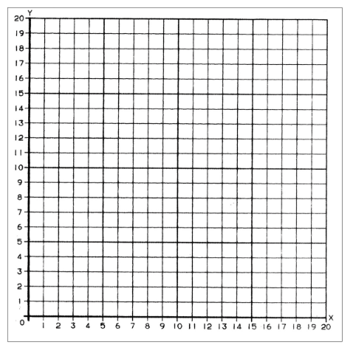
Today’s New Vocab (4 of 4)
Graph k(x) = ${16∙\frac{1}{4}}^{x}$
over the interval
of 0 $≤x≤2$
The origin (0,0) is in the corner.
Zoom in.
x | k(x)
0 | 16
1 | 4
2 | 1
Page #15
Lesson 6.4
Growth or Decay?

Slide 48
Group Work Questions
Page #13-14
Lesson 6.4
#1
#2
#3
#4
#5
2,5,6,9
#6
#7
#8
#9
#10
2,7,8,9
#3 and #4 are decimals answers.
2,7,8,9
2,5,6,9
2,5,6,9
2,7,8,9
2,7,8,9
2,5,6,9
2,5,6,9
2,7,8,9

Slide 49
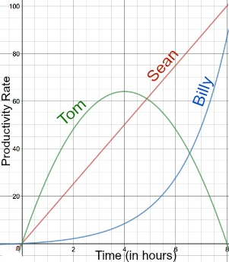
Wednesday Feb 26, 2020 Work Period
Page #16
Lesson 6.4
Who is the most productive in hour 2 and 6?
Tom and Sean
What is his productivity rate at those hours?
75
.
47
27
T(2) = 47 T(6) = 47
S(2) = 25 S(6) = 75
B(2) = 3 B(6) = 27
3

Slide 50
Wednesday Feb 26, 2020 Exit Ticket
When x = 2, what is j(2) ?
Page #16
Lesson 6.4
Evaluate j(x) = ${3∙5}^{x}$ the function.
j(2) = ${3∙5}^{(2)}$
x | j(x)
0 | 3
1 | 15
2 | 75
j(2) = 3 $∙5$(5)
j(2) = 3$∙25$
j(2) = 75

Slide 52
Page #19
Lesson 6.5
Friday Feb 28, 2020 Activator
Given the following pattern. What is $A_{8}?$
+6
+6
+6
44
2, 8, 14, ___, ___, ___, ___, ___
20
26
32
38
$$a_{1}$$
$$a_{2}$$
$$a_{3}$$
$$a_{4}$$
$$a_{5}$$
$$a_{6}$$
$$a_{7}$$
$$a_{8}$$
Is this an exponential pattern? No
Why? There is repeated addition, not multiplication.

Slide 53
Today’s Objective
Unit 6
Lesson 5
Students will be able to write recursive patterns given the function.

Slide 54
Mon(x) | Tue(B) | Wed(C) | Thur(D) | Fri(A)
President’s Day | Lesson 6.1 | x | Lesson 6.2 | x
Mon(B) | Tue(C) | Wed(D) | Thur(A) | Fri(B)
Lesson 6.3 | x | Lesson 6.4 | x | 2B: L6.5 3B: Assembly and L6.5 5B: L6.5

Slide 55
Announcements
Best in Class
Friday Assembly: 3rd Period during ½ class
Tutoring on Monday is CANCELED.
Tutoring: Wed 2:45-3:45, Fri 7:45-8:30
Test 5 is in Yellow, Q3 Progress Pink
Q3 Progress Grades go home on March 6th

Slide 56
Today’s New Vocab (1 of 4)
If y = 12x – 7, what is y when x = 3?
y = 12(3) – 7
+12
+12
+12
x | Y
0 | -7
1 | 5
2 | 17
3 | 29
y = 36 – 7
-7, 5, 17, 29,
$$a_{0}$$
$$a_{1}$$
$$a_{2}$$
$$a_{3}$$
y = 29
$$a_{3}=29$$
Video
Page #19
Lesson 6.5
https://www.youtube.com/watch?v=v1ucHH06AxM 3min

Slide 57
Today’s New Vocab (2 of 4)
Write the recursive pattern $A_{n+1}$ = $A_{n}−2$
$$A_{1 }=6$$
$A_{n+1}$ = The next number
-2
-2
Page #19
Lesson 6.5
-2
6, 4, 2, ___, ___, ___, ___, ___
$$a_{1}$$
$$a_{2}$$
$$a_{3}$$
$$a_{4}$$
$$a_{5}$$
$$a_{6}$$
$$a_{7}$$
$$a_{8}$$
Is this pattern Linear? Yes, it is repeated subtraction.

Slide 58
Today’s New Vocab (3 of 4)
Explicit formula
Y = MX + B
Y = -2x + 6
Recursive formula
$A_{n+1}=A_{n}−2$
$$A_{1}=4$$
$A_{0}=$ B = 6
Page #19
Lesson 6.5
-2
-2
-2
-4
-6
-8
6, 4, 2, ___, ___, ___, ___, ___
0
-2
$$a_{0}$$
$$a_{1}$$
$$a_{2}$$
$$a_{3}$$
$$a_{4}$$
$$a_{5}$$
$$a_{6}$$
$$a_{7}$$

Slide 59
Today’s Misconception (4 of 4)
Write the recursive formula.
Page #20
Lesson 6.5
$$A_{n+1}=A_{n}+3$$
$A_{0}=$ B $=2$
$A_{1}=$ 5
.
$$+3$$
$$+3$$

Slide 60
Group Work Questions
Page #17-18
Lesson 6.5
#1
#2
#3
#4
#5
1, 2, 3, 4
#6
#7
#8
#9
#10
3, 4, 1, 2
3, 4, 1, 2
1, 2, 3, 4
1, 2, 3, 4
3, 4, 1, 2
3, 4, 1, 2
1, 2, 3, 4
1, 2, 3, 4
3, 4, 1, 2

Slide 61
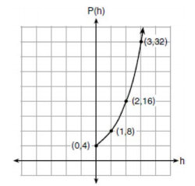
Friday Feb 28, 2020 Work Period
Write the recursive formula.
Page #20
Lesson 6.5
$$P_{h+1}= (2)P_{h}$$
$P_{0}$ $=4$
h | P(h)
0 | 4
1 | 8
2 | 16
0 | 32
.
$$(2)$$
$$P_{0+1}= (2)P_{0}$$
$$P_{1}= (2)(4)$$
$$(2)$$
$$(2)$$
$$P_{1}=8$$

Slide 62
Friday Feb 28, 2020 Exit Ticket
Write the recursive formula. What is $T_{8}$?
$$T_{7+1}=T_{7}+3$$
$$T_{n+1}=T_{n}+3$$
$$T_{1}=−9$$
$$T_{8}=9+3$$
Page #20
Lesson 6.5
$T_{8}=12$
+3
+3
+3
-9, -6, -3, 0, 3, 6, 9, 12
$$T_{1}$$
$$T_{2}$$
$$T_{3}$$
$$T_{4}$$
$$T_{5}$$
$$T_{6}$$
$$T_{8}$$
$$T_{7}$$

Slide 64
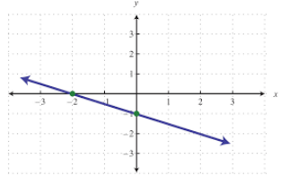
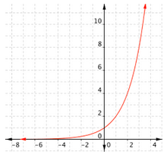
Tuesday March 3, 2020 Activator
Linear or Exponential graph? Why?
f(x) = $\frac{−1}{2}$x -1
f(x) = 1($2^{x})$
Straight
It has an
Exponent.
Linear
Page #23
Lesson 6.6
Exponential

Slide 65
Today’s Objective
Unit 6
Lesson 6
Students will be able to write the difference between linear and exponential word problems.

Slide 66
Mon(C) | Tue(D) | Wed(A) | Thur(B) | Fri(C)
x | Unit 6.6 | x | Unit 6.7 | x
Mon(D) | Tue(A) | Wed(B) | Thur(C) | Fri(D)
Review Unit 6 | x | Test Unit 6 | x | Unit 7.1

Slide 67
Announcements
Best in Class
3rd Period has 2 extra slides from Friday to do.
Tutoring: Wed 2:45-3:45, Fri 7:45-8:30
Test 5 is in Yellow, Q3 Progress Pink
Q3 Progress Grades go home on Fri, March 6th

Slide 68
Today’s New Vocab (1 of 4)
A Gold’s gym membership costs $100 to sign-up and $10 dollars per month.
Page #23
Lesson 6.6
x | C(x)
0 | 100
1 | 110
2 | 120
3 | 130
Is the situation linear
or exponential?
Linear
Why? Adds $10 per month
+10
+10
+10
Explain C(0): The beginning cost

Slide 69
Today’s New Vocab (2 of 4)
Write an equation and function to model this situation.
Equation: y = mx + b
x | C(x)
0 | 100
1 | 110
2 | 120
3 | 130
Function: C(x) = mx + b
M = $10 = the monthly payment
+10
B = $100 = Beginning Sign-up Fee
+10
C(x) = $10x + $100
+10

Slide 70
Today’s New Vocab (3 of 4)
Is the situation linear or exponential?
You have discovered you have termites. Termites reproduce at a rapid pace. Some termite colonies can double
in size monthly. You currently have
about 100 termites in your house.
x | f(x)
0 | 100
1 | 200
2 | 400
3 | 800
(2)
(2)
Exponential Why?
Repeated Multiplication
(2)

Slide 71
Today’s New Vocab (4 of 4)
Write an equation (function) to model this situation.
Equation: y = b($c^{x})$
x | f(x)
0 | 100
1 | 200
2 | 400
3 | 800
Function: f(x) = b${(C)}^{x}$
(2)
C = (2) = Doubles (Times 2)
(2)
B = 100 = Beginning Termites
f(x) = 100($2^{x})$
(2)
Page #24
Lesson 6.6

Slide 72
Today’s New Vocab (3 of 4)
Explicit formula
Y = MX + B
Y = -2x + 6
Recursive formula
$A_{n+1}=A_{n}−2$
$$A_{1}=4$$
$A_{0}=$ B = 6
Page #19
Lesson 6.5
-2
-2
-2
-4
-6
-8
6, 4, 2, ___, ___, ___, ___, ___
0
-2
$$a_{0}$$
$$a_{1}$$
$$a_{2}$$
$$a_{3}$$
$$a_{4}$$
$$a_{5}$$
$$a_{6}$$
$$a_{7}$$

Slide 73
Today’s Misconception (4 of 4)
Write the recursive formula.
Page #20
Lesson 6.5
$$A_{n+1}=A_{n}+3$$
$A_{0}=$ B $=2$
$A_{1}=$ 5
.
$$+3$$
$$+3$$

Slide 74
Group Work Questions
Page #21-22
Lesson 6.6
#1
#2
#3
#4
#5
1, 5, 6
#6
#7
#8
#9
#10
1, 6, 5
Skip
5D
6E
1, 6, 5
1, 5, 6
1, 5, 6
1, 6, 5
1, 6, 5
1, 5, 6
1, 5, 6
1, 6, 5

Slide 75
Tuesday March 3, 2020 Work Period
Last weekend, Emma sold lemonade at a yard sale. Emma earned money selling c cups. Sales were strong, so she raised the price from 50 cents to 75 cents per cup. She spent $9.96 on supplies each week. Write the function which represents her profit, P(c) for this last weekend and this weekend.
.
Let c = The number of cups
P(c)= $0.50c - 9.96 last weekend
Page #24
Lesson 6.6
+$0.25C
P(c)= $0.75c - 9.96 this weekend

Slide 76
Tuesday March 3, 2020 Exit Ticket
Emma sold 80 cups of lemonade each weekend, how
much money did she make selling lemonade each week?
P(c) = $0.50c - 9.96
P(c) = $0.75c - 9.96
P(80) = $0.50(80)-9.96
P(80) = $0.75(80) - 9.96
P(80) = $40 - 9.96
P(80) = $60- 9.96
P(80) = $30.04
P(80) = $50.04
Last weekend
This weekend

Slide 78
Thursday March 5, 2020 Activator
Page #27
Lesson 6.7
Given this table,
what is the beginning
Value (B-value)? B = 4
x | y
-2 | 1
-1 | 2
0 | 4
1 | 8
(2)
(2)
(2)
Is this a linear or exponential graph? Exponential
Why? Repeated Multiplication

Slide 79
Today’s Objective
Unit 6
Lesson 7
Students will be able to write exponential equations and functions.

Slide 80
Mon(C) | Tue(D) | Wed(A) | Thur(B) | Fri(C)
x | Unit 6.6 | x | Unit 6.7 | x
Mon(D) | Tue(A) | Wed(B) | Thur(C) | Fri(D)
Review Unit 6 | x | Test Unit 6 | x | Unit 7.1

Slide 81
Announcements
Best in Class
Tutoring: Fri 7:45-8:30, Mon 2:45-3:45
Did you get my message this morning?
Show it to me for a chip.
Join our Remind Group To: 81010
Text this Message: @algebramrv
Test 5 is in Yellow, Q3 Progress Pink
Q3 Progress Grades go home on March 6th

Slide 82
Today’s New Vocab (1 of 4)
Given this table,
write a function.
C = $\frac{A_{2}}{A_{1}}=\frac{16}{8}=(2)$
Page #27
Lesson 6.7
x | f(x)
-1 | 2
0 | 4
1 | 8
2 | 16
(2)
(2)
(2)
F(x) = b${(C)}^{x}$
Formula
f(x) = 4${(2)}^{x}$

Slide 83
Today’s New Vocab (2 of 4)
Write the exponential function.
Evaluate for F(3).
x | F(x)
0 | 4
1 | 8
2 | 16
3 | 32
F(x) = B ${(C)}^{x}$
B = 4
C = (2)
F(x) = 4 ${(2)}^{x}$
F(3) = 4 ${(2)}^{3}$
F(3) = 4(2)(2)(2)
Page #27
Lesson 6.7
F(3) = 32

Slide 84
Today’s New Vocab (3 of 4)
Graph the function.
F(x) = 4 ${(2)}^{x}$
Is this
exponential
growth or decay?
x | F(x)
-2 | 1
-1 | 2
0 | 4
1 | 8
Growth Why?

Slide 85
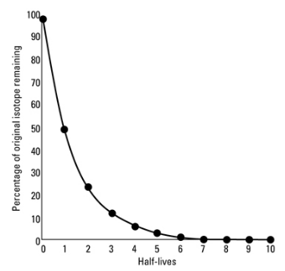
(4 of 4)
Make a table, and
write an equation.
y = B ${(C)}^{x}$
C = $\frac{A_{2}}{A_{1}}=\frac{25}{50}=(\frac{1}{2})$
x | y
0 | 100
1 | 50
2 | 25
3 | 12.5
$(\frac{1}{2})$
y = 100 ${(\frac{1}{2})}^{x}$
$(\frac{1}{2})$
Growth? Decay?

Slide 86
Group Work Questions
Page #25-26
Lesson 6.7
#1
#2
#3
#4
#5
1, 4, 8
#6
#7
#8
#9
#10
6, 4, 8
#5, #3 have
decimal B
values
2, 4, 8
1, 4, 8
6, 4, 8
2, 4, 8
1, 4, 8
6, 4, 8
#7 $A_{2} is a$
$$decimal.$$
2, 4, 8
1, 4, 8

Slide 87
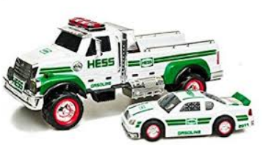
Thursday March 5, 2020 Work Period
The manufactures of Hess toys cost of $125 to design
and $5.25 manufacture each toy.
If the cost of manufacturing t toys, write the function.
.
Linear or exponential? Linear b/c addition $5.25
y = mx + b
Equation
Page #28
Lesson 6.7
C(t) = mt + b
C(t) = 5.25t + 125

Slide 88
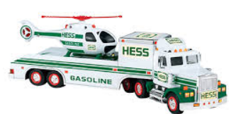
Thursday March 5, 2020 Exit Ticket
The Hess company wants to know how much it will cost to manufacture 250 toys.
c(t) = $5.25t + $125
.
c(250) = $5.25(250) + $125
c(250) = $1312.50 + $125
c(250) = $1437.50
It will cost $1437.50
to manufacture 250 toys.

Slide 90
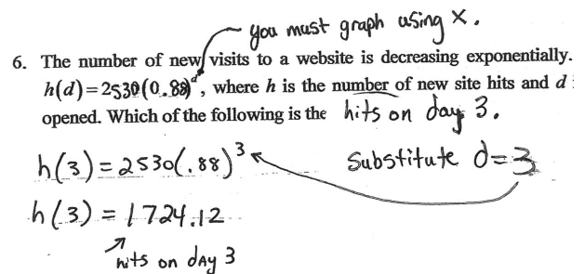
Monday March 9, 2020 Activator
#6
Page #30
Unit 6 Review
$\frac{88}{100}$ = 0.88
C < 1 This graph is decreasing.

Slide 91
Today’s Objective
Unit 6
Review
Students will be able to review all objectives from Unit 6.

Slide 92
Announcements
Best in Class
Tutoring: Mon 2:40-3:40, Thurs 7:45-8:30
Friday Tutoring Canceled. Eye Doctor…
Unit #6 Test next class
All Q’s are 5%.
Classwork is due next class.
Homework is due next class.

Slide 93
Mon(C) | Tue(D) | Wed(A) | Thur(B) | Fri(C)
x | Unit 6.6 | x | Unit 6.7 | x
Mon(D) | Tue(A) | Wed(B) | Thur(C) | Fri(D)
Review Unit 6 | x | Test Unit 6 | x | Project & Sub Teacher

Slide 94
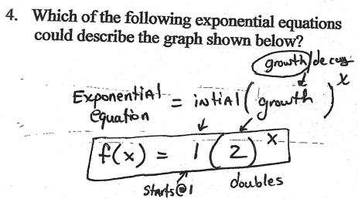
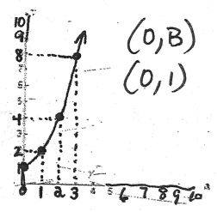
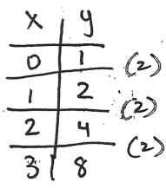
Today’s New Vocab (1 of 4)
Growth or decay?
#4
Page #29
Unit 6 Review

Slide 95
Simplify
Today’s
(2 of 4)
#10
Page #31
Unit 6 Review

Slide 96
Today’s New Vocab (3 of 4)
#17 What is the 9th term?
3072
3, 12, 48, ___, ___, ___, _____,
192
768
12288
$$a_{0}$$
$${ a}_{1}$$
$${ a}_{2}$$
$$a_{3}$$
$$a_{4}$$
$$a_{5}$$
$$a_{6}$$
____, _____, _______,
49152
196608
786432
$$a_{7}$$
$${ a}_{8}$$
$${ a}_{9}$$
C = $\frac{A_{2}}{A_{1}}=\frac{48}{12}=(4)$
What is
the pattern?
#18

Slide 97
New Vocab (4 of 4)
Page #32
Unit 6 Review
#15: Increasing or decreasing? decreasing
Why? C < 1 Multiplier is Less than 1
.
t | P(t)
11

Slide 98
GWQ’s Skip #7
Page #29-32
Unit 6 Review
#1
#2
#3
#4
#5
1, 12, 5, 14
#6
#7
#8
#9
#10
2, 3, 9, 14
2, 3, 9, 14
1, 12, 5, 14
1, 12, 5, 14
2, 3, 9, 14
2, 3, 9, 14
1, 12, 5, 14
1, 12, 5, 14
2, 3, 9, 14

Slide 99
Monday March 9, 2020 Exit Ticket
#7
Determine the 3rd term in the pattern 28, 112, ____.
How do you calculate the
common multiplier?
Page #30
Unit 6 Review
$$\left(4\right) \left(4\right)$$
448
$$A_{1} A_{2} A_{3}$$
x | A(x)
1 | 28
2 | 112
3 | 448
C = $\frac{A_{2}}{A_{1}}=\frac{112}{28}=(4)$
$$\left(4\right)$$

Slide 101
Wednesday March 11, 2020 Activator
Please take out your Homework
Please take out your Classwork
Unit #6 Test: All Questions 5%
No work needed on #2, #4, #11
Extra Credit project next class (Add 5%)
You must receive at least a 65%, or you
must stay after school to complete it.
Extended Time: Thur 7:45-8:30, Mon 2:45-3:45
must pass by the end of Q3 Friday, April 17th

Slide 102
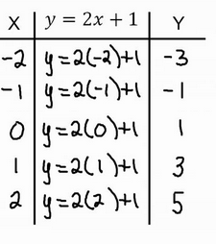
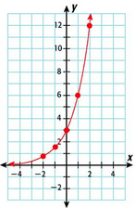
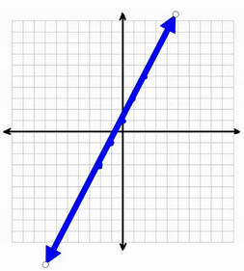
Determine if the table is linear or exponential.
Repeated Addition
Repeated Multiplication
Linear
Exponential
ALGEBRA
(2)
+2
+2
(2)
+2
(2)
+2
(2)

